Slide 1
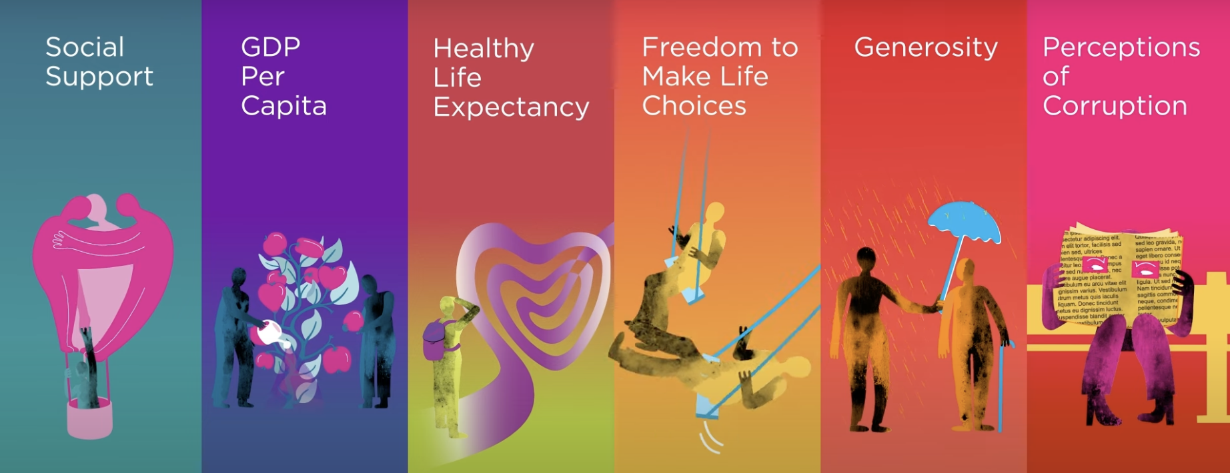
How do we measure happiness?

Slide 2
Data Visualization
Project Group 3
TEAM MEMBERS:
Kassidy MunnMinoda
Kiki Chan
Elizabeth Conn
Elif Celebi
Carlos Ortiz
Measuring Happiness

Slide 3
Agenda
Dataset Overview
JavaScript Mapping
Streamlit App
Statistical Analysis
Q&A
Measuring Happiness

Slide 4
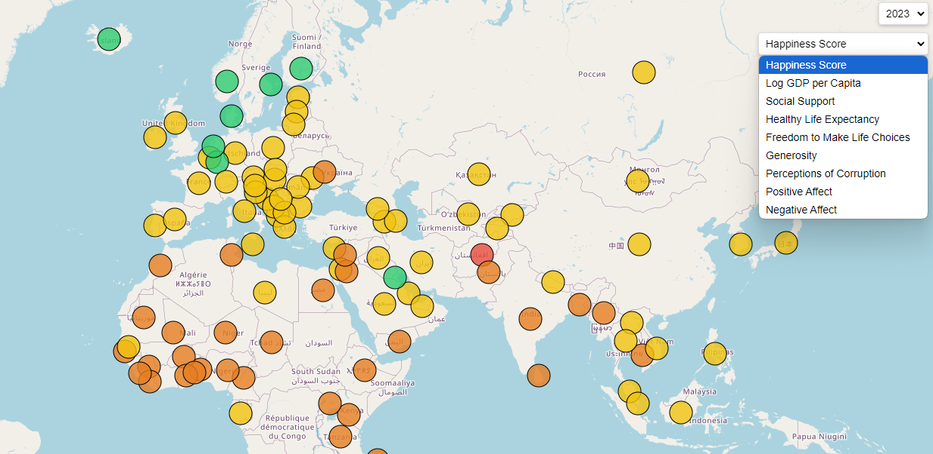
JavaScript Mapping
Visualizing global happiness throughout the years

Slide 5
JavaScript Mapping
Initialize map with Leaflet.js
Add tile layers from OpenStreetMap
Create markers and clusters for countries
Dropdowns to filter by year and data type
Visualize different countries with circle markers
Markers change color based on the value of the selected metric
Example: High happiness scores are shown in green, low scores in red

Slide 6
JavaScript Mapping
Initialize map with Leaflet.js
Add tile layer from OpenStreetMap
Load GeoJSON data
Fetch country and happiness index data (2008-2023)
Animate map updates
Control play/stop
Add label displaying a country’s name and index score when hovering over it

Slide 7

Streamlit is an open-source Python framework to deliver dynamic apps with only a few lines of code!

Slide 8
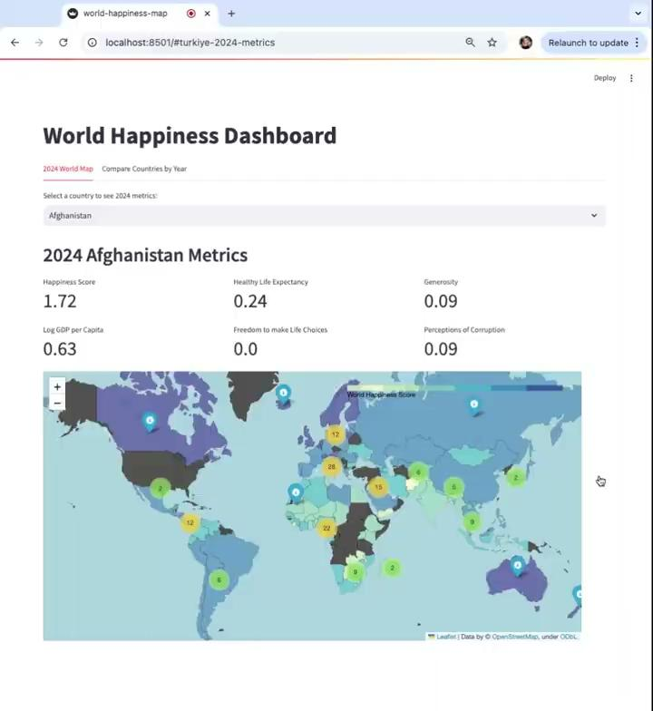
T
U
T
O
R
I
A
L

Slide 9
Statistical Analysis
Happiness Score against
other variables
across countries.

Slide 10
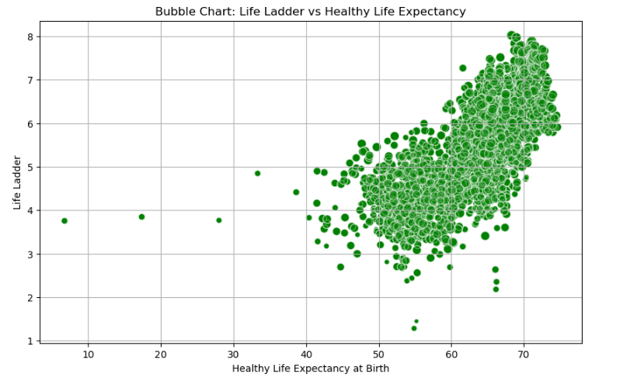
Life Ladder vs Healthy Life Expectancy at Birth
Positive trend between Healthy Life Expectancy at Birth and the Life Ladder score.
Bubble sizes are representing “Freedom to Make Life Choices”.
This chart suggests that countries with longer Healthy Life Expectancy at Birth tend to have higher Life Ladder scores (well-being).

Slide 11
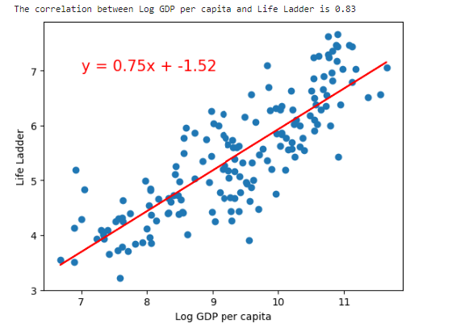
Log GDP per Capita vs Life Ladder
The correlation coefficient, 𝑟=0.83, indicates a strong positive relationship between these two variables
As GDP per capita increases, the Life Ladder score tends to increase as well.
The general trend : countries with higher Log GDP per capita tend to have higher Life Ladder scores.
Economic growth, as measured by GDP per capita, is closely linked to life satisfaction across countries.

Slide 12

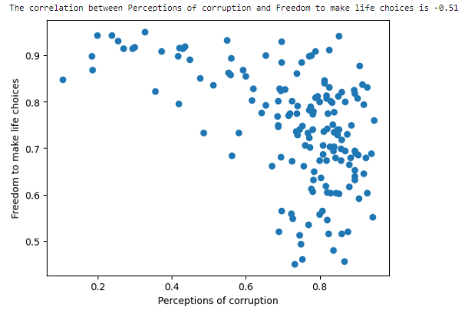
Freedom to make life choices vs Perceptions of corruption
In countries where corruption is perceived to be higher, people generally report lower freedom to make life decisions.

Slide 13
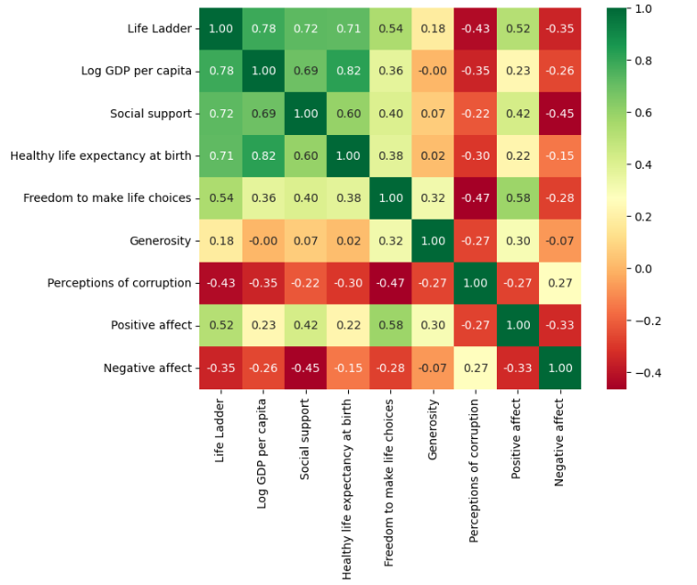
Correlation Heatmap

Slide 14
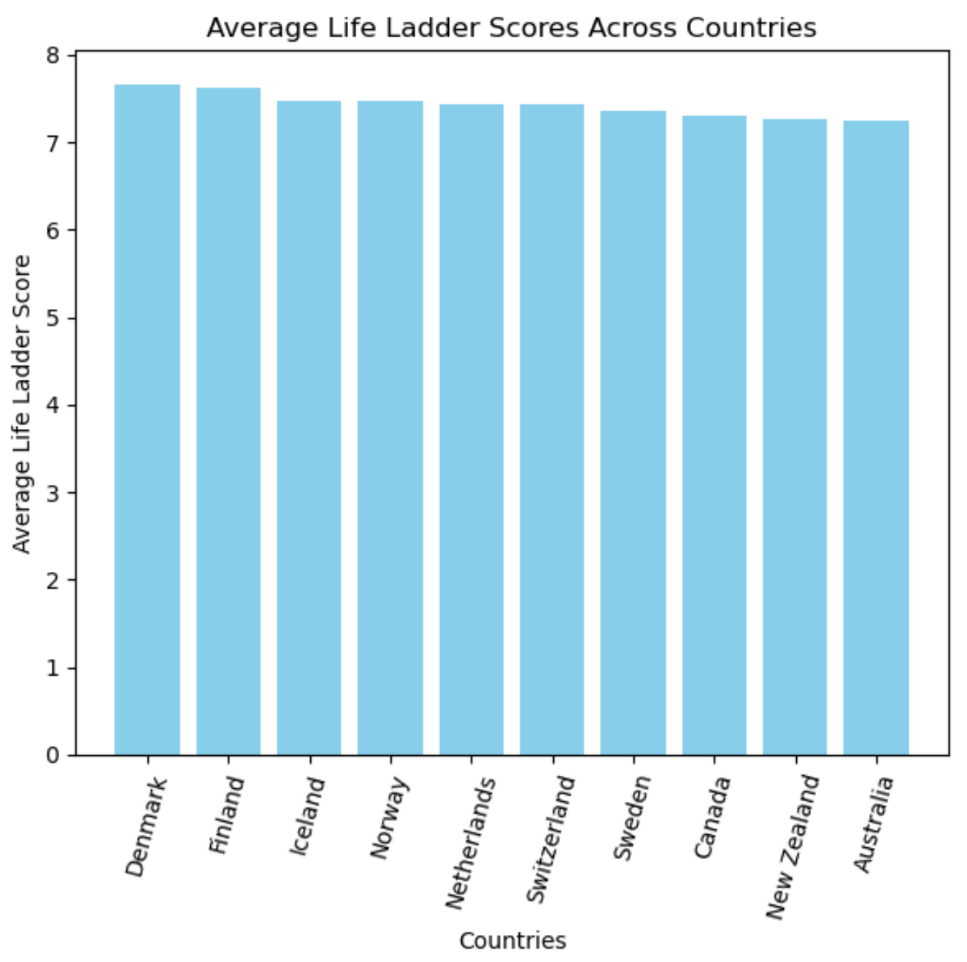
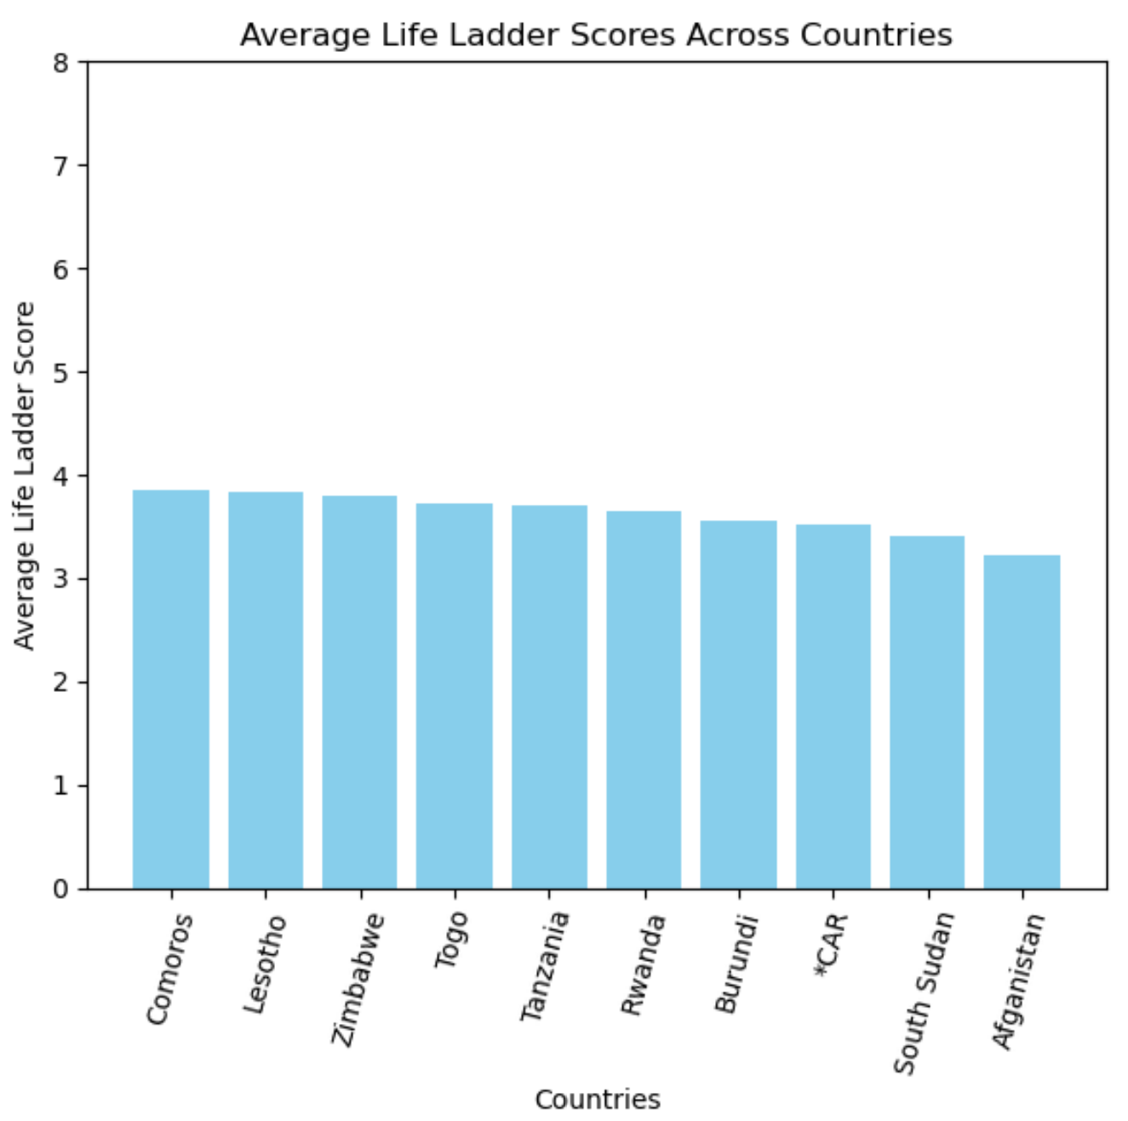
Average Life Ladder Scores
Top 10 Countries | Bottom 10 Countries
*Central African Republic

Slide 15
Thank you!
Open for Q & A

